Slide 1
Structure of a Warm Front

Slide 2
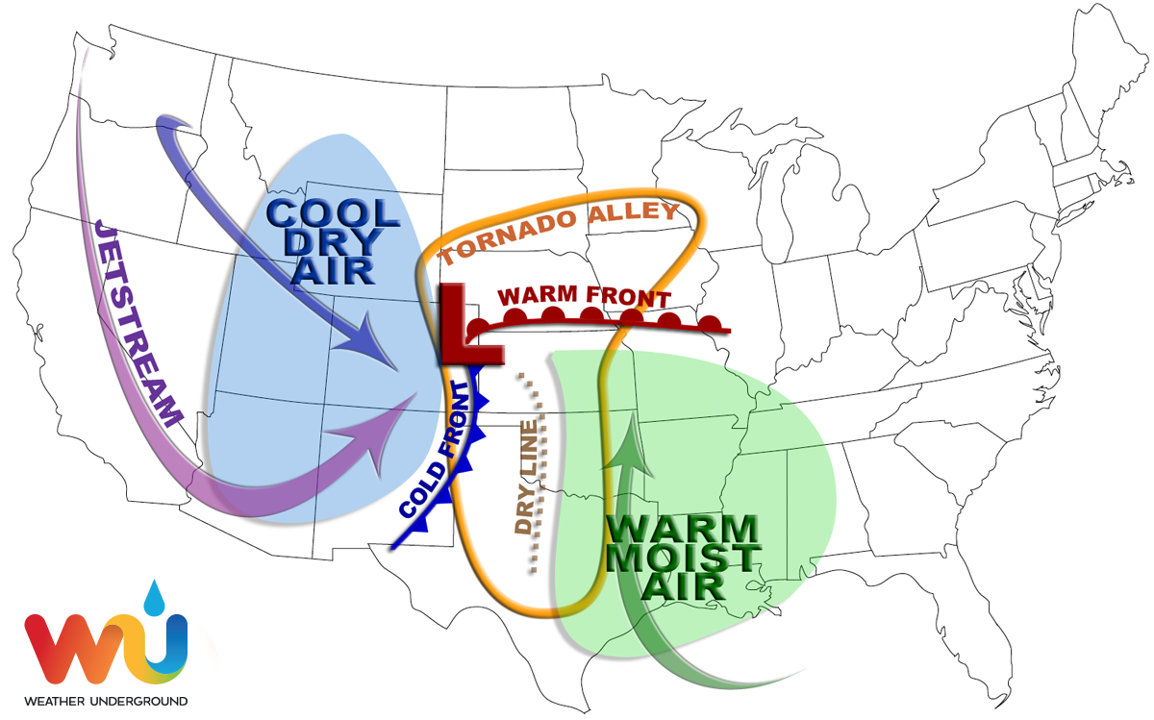
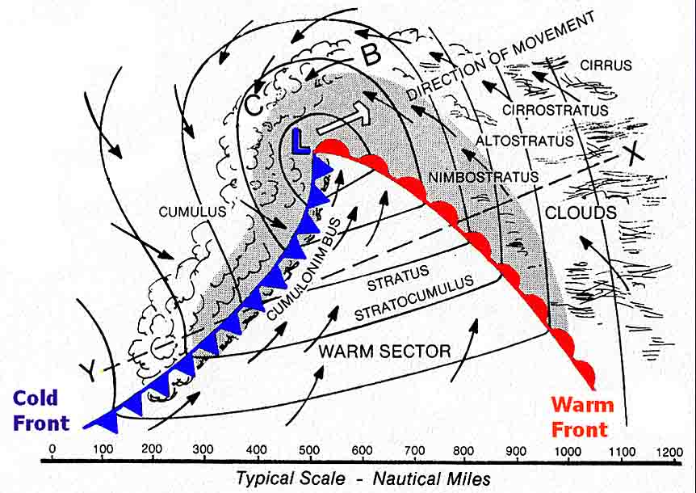
What is a Warm Front?
A warm front occurs when a warm air mass moves into a cold air mass.

Slide 3
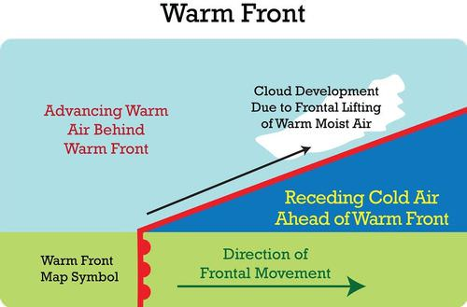
Structure of a Warm Front
Warm fronts have a larger horizontal extent than a vertical extent as warm air rises over the cold air.
Warm air is less dense than cold air, which causes the air to rise.

Slide 4
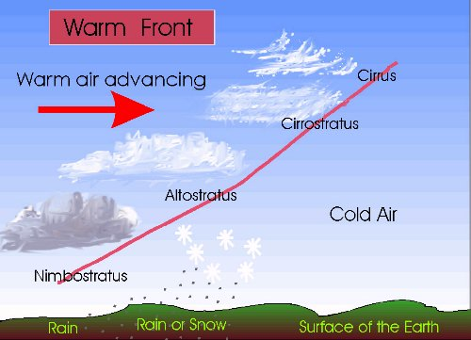
Clouds and Precipitation
Warm fronts are usually characterized by widespread cloud cover and steady precipitation.
Clouds are called “stratiform” due to their layered structure.

Slide 5
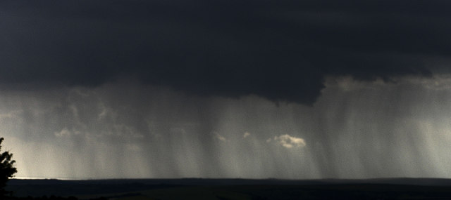
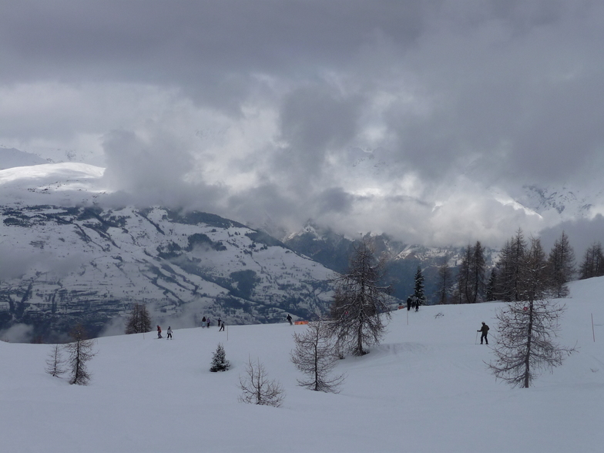
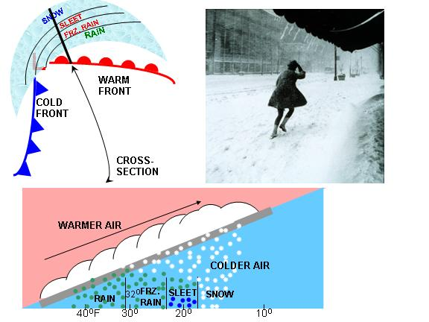
Clouds and Precipitation
Warm fronts are often associated with widespread rainfall or snowfall, depending on the season.

